Slide 1
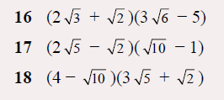
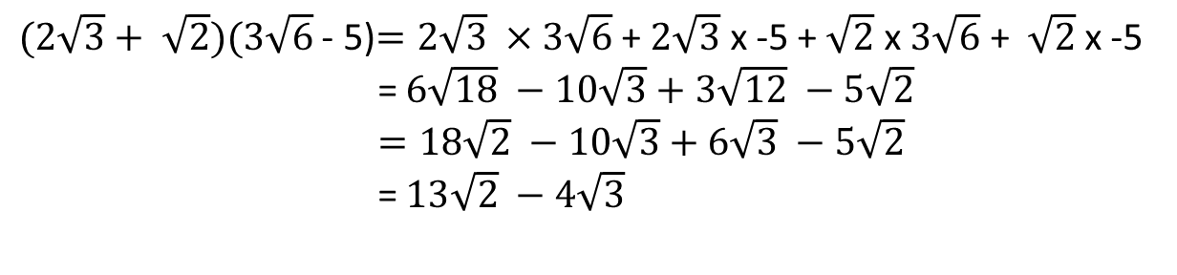
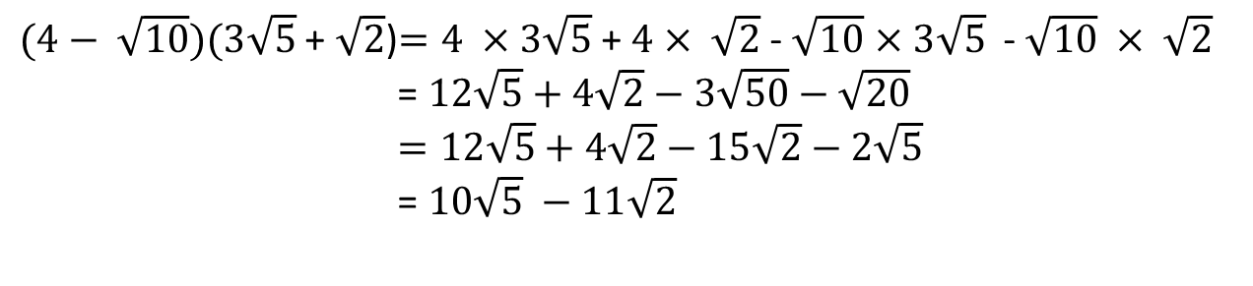
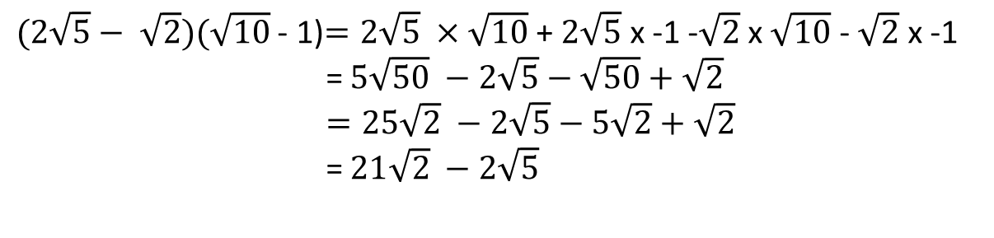
$(2\sqrt{3}+ \sqrt{2})(3\sqrt{6}$ - 5)$=2\sqrt{3} ×3\sqrt{6}$ + $2\sqrt{3}$ x -5 + $\sqrt{2}$ x $3\sqrt{6}$ + $\sqrt{2}$ x -5
= $6\sqrt{18} −10\sqrt{3}+3\sqrt{12} −5\sqrt{2}$
$=18\sqrt{2} −10\sqrt{3}+6\sqrt{3} −5\sqrt{2}$
= $13\sqrt{2} −4\sqrt{3}$
$(2\sqrt{5}− \sqrt{2})(\sqrt{10}$ - 1)$=2\sqrt{5} ×\sqrt{10}$ + $2\sqrt{5}$ x -1 -$\sqrt{2}$ x $\sqrt{10}$ - $\sqrt{2}$ x -1
= $5\sqrt{50} −2\sqrt{5}−\sqrt{50}+\sqrt{2}$
$=25\sqrt{2} −2\sqrt{5}−5\sqrt{2}+\sqrt{2}$
= $21\sqrt{2} −2\sqrt{5}$
$(4− \sqrt{10})(3\sqrt{5}$ + $\sqrt{2}$)$=4 ×3\sqrt{5}$ + $4$ $× \sqrt{2}$ - $\sqrt{10}$ $×$ $3\sqrt{5}$ - $\sqrt{10} × \sqrt{2}$
= $12\sqrt{5}+4\sqrt{2}−3\sqrt{50}−\sqrt{20}$
$=12\sqrt{5}+4\sqrt{2}−15\sqrt{2}−2\sqrt{5}$
= $10\sqrt{5} −11\sqrt{2}$

Slide 2

$$\sqrt{12}= \sqrt{4 ×3}=2\sqrt{3}$$
Write the following as a single surd:
$2\sqrt{3}$ = $\sqrt{12}$
$5\sqrt{2}$ = $\sqrt{50}$
$3\sqrt{5}$ = $\sqrt{45}$
$2\sqrt{11}$ = $\sqrt{44}$

Slide 3
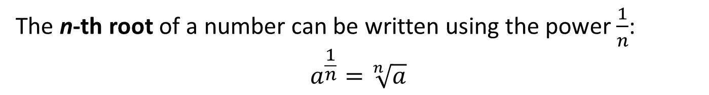
24
7
30
Title: Fractional Exponents
EQ : How do I express a fractional exponent as a surd?
Question:
Notes:
Fractional exponents can be used instead of using the surds sign (√).
We use fractional exponents because often they are more convenient, and it can make algebraic operations easier to follow.
The n-th root of a number can be written using the power $\frac{1}{n}$:
$$a^{\frac{1}{n}}=\sqrt[n]{a}$$
17

Slide 4
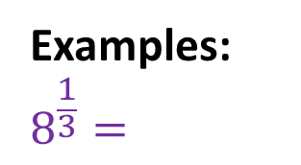
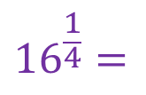


24
7
30
Title: Fractional Exponents
EQ : How do I express a fractional exponent as a surd?
Examples:
$$8^{\frac{1}{3}}=$$
$$\sqrt[3]{8 }=$$
2
$${16}^{\frac{1}{4}}=$$
$\sqrt[4]{16 }=$
2
17

Slide 5
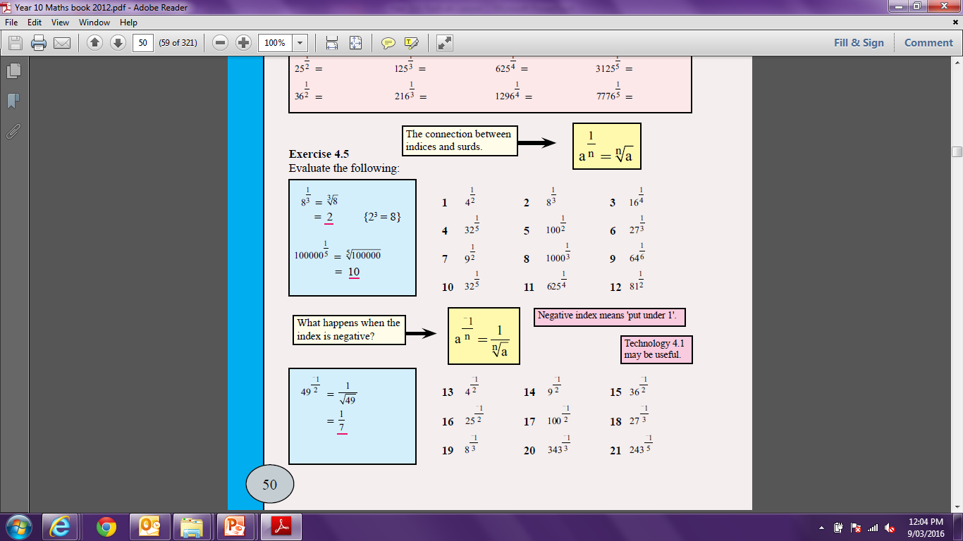

Slide 6

24
7
30
Title: Fractional Exponents
EQ : How do I express a fractional exponent as a surd?
Question:
When the exponent is negative:
$$a^{\frac{−1}{n}}=\frac{1}{\sqrt[n]{a}}$$
17

Slide 7


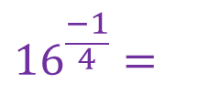


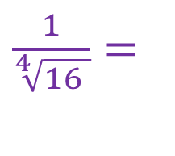
24
7
30
Title: Fractional Exponents
EQ : How do I express a fractional exponent as a surd?
Examples:
$$8^{\frac{−1}{3}}=$$
$$\frac{1}{\sqrt[3]{8 }}=$$
$$\frac{1}{2}$$
$${16}^{\frac{−1}{4}}=$$
$\frac{1}{\sqrt[4]{16 }}=$
$$\frac{1}{2}$$
17

Slide 9
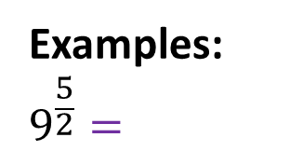



24
7
30
Title: Fractional Exponents
EQ : How do I express a fractional exponent as a surd?
Examples:
$$9^{\frac{5}{2}}=$$
$$(\sqrt[2]{9})^{5}$$
$$= 3^{5}$$
$$=243$$
17

Slide 10
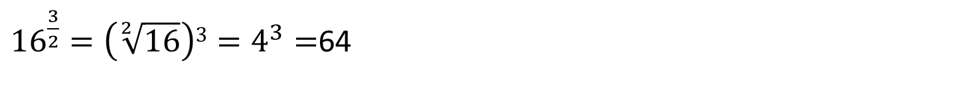
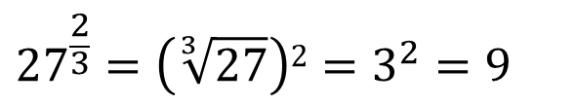
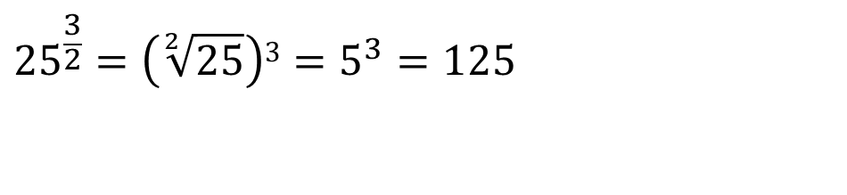
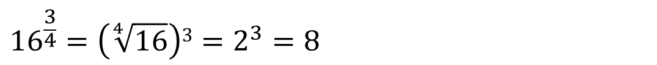
Questions
$${27}^{\frac{2}{3}}=\left(\sqrt[3]{27}\right)2=3^{2}=9$$
${16}^{\frac{3}{2}}=\left(\sqrt[2]{16}\right)3=4^{3}=$64
$${16}^{\frac{3}{4}}=\left(\sqrt[4]{16}\right)3=2^{3}=8$$
$${25}^{\frac{3}{2}}=\left(\sqrt[2]{25}\right)3=5^{3}=125$$

Slide 11
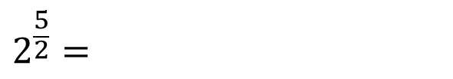
Questions
$$2^{\frac{5}{2}}=$$
$$3^{\frac{3}{2}}=$$
$$5^{\frac{3}{2}}=$$

Slide 12
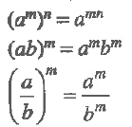

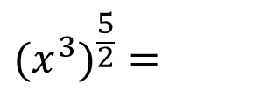



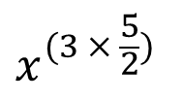

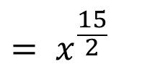

Title: Fractional Exponents and Index Laws
EQ : How do I apply the index laws to fractional exponents?
Index Law:
$$(x^{3})^{\frac{5}{2}}=$$
$$x^{(3 × \frac{5}{2})}$$
$$= x^{\frac{15}{2}}$$
$$(\frac{4}{9})^{\frac{3}{2}}=$$
$$\frac{(\sqrt[2]{4})^{3}}{(\sqrt[2]{9})^{3}}=$$
$$\frac{8}{27}$$
$$(\frac{4}{9})^{\frac{−3}{2}}=$$
$$\frac{(\sqrt[2]{9})^{3}}{(\sqrt[2]{4})^{3}}=$$
$$\frac{27}{8}$$
17

Slide 13
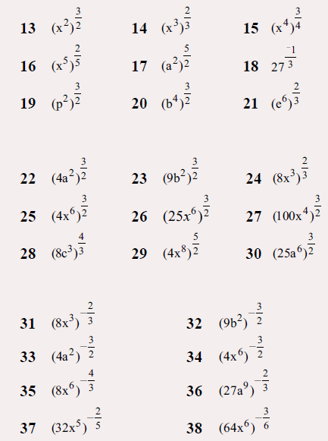
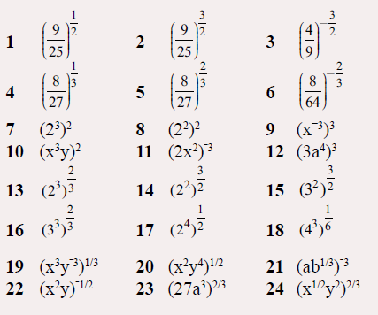

Slide 14
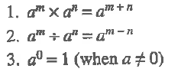
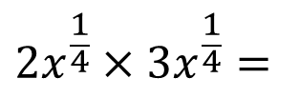
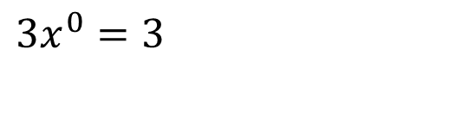
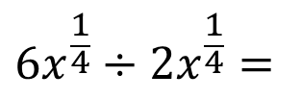
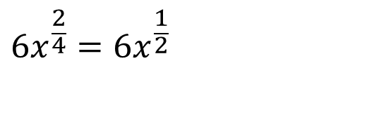
Title: Fractional Exponents and Index Laws
EQ : How do I apply the index laws to fractional exponents?
Index Law:
$$2x^{\frac{1}{4}}×3x^{\frac{1}{4}}=$$
$$6x^{\frac{2}{4}}=6x^{\frac{1}{2}}$$
$$6x^{\frac{1}{4}}÷2x^{\frac{1}{4}}=$$
$$3x^{0}=3$$
17

Slide 15
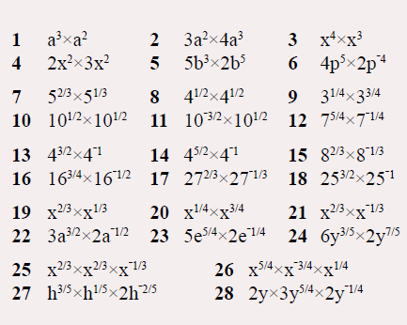
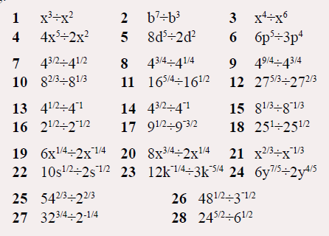

Slide 16
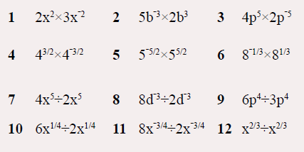

Slide 17
Homework
Review your notes and write a summary answering the essential question.

